Slide 1
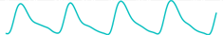
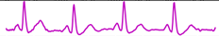
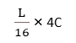
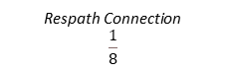

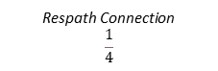

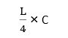
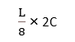



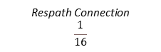
Input
L
$\frac{L}{4}$ × B
Cyc. S
Signal Patch Partition
Linear Projection
L × C
Layer Norm
Layer Norm
Respath Connection
$$\frac{1}{4}$$
Patch Expanding
Linear Embedding
q
k
v
q
k
v
$\frac{L}{4}$ × C
1D SwinTransformer Block X2
1D SwinTransformer Block X2
$\frac{L}{4}$ × C
W-MHSA
SW-MHSA
Patch Expanding
Patch Merging
Respath Connection
$$\frac{1}{8}$$
$\frac{L}{8}$ × 2C
1D SwinTransformer Block X2
1D SwinTransformer Block X2
$\frac{L}{8}$ × 2C
RPE
RPE
Patch Expanding
Layer Norm
Layer Norm
Patch Merging
Respath Connection
$$\frac{1}{16}$$
$\frac{L}{16}$ × 4C
1D SwinTransformer Block X2
1D SwinTransformer Block X2
$\frac{L}{16}$ × 4C
MLP
MLP
Patch Expanding
Patch Merging
Encoder
1D SwinTransformer Block X1
1D SwinTransformer Block X1
Decoder
$\frac{L}{32}$ × 8C
BottleNeck
Output
Generator: 1DCyclicSwinUnet
Shifted Window Transformer Block

Slide 2
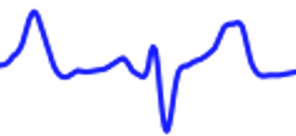
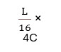

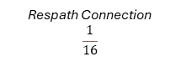
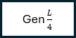
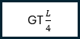

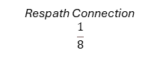
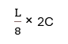

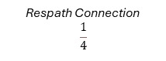
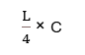
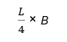
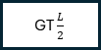
D
D
D
GT $\frac{L}{2}$
Gen $\frac{L}{2}$
GT $\frac{L}{4}$
Gen $\frac{L}{4}$
L
$\frac{L}{4}$ × B
Cyc. S
Signal Patch Partition
Linear Projection
Linear Projection
Linear Projection
L × C
Respath Connection
$$\frac{1}{4}$$
Patch Expanding
Patch Expanding
Patch Expanding
Linear Embedding
$\frac{L}{4}$ × C
1D SwinTransformer Block X2
1D SwinTransformer Block X2
$\frac{L}{4}$ × C
Patch Expanding
Patch Merging
Respath Connection
$$\frac{1}{8}$$
$\frac{L}{8}$ × 2C
1D SwinTransformer Block X2
1D SwinTransformer Block X2
$\frac{L}{8}$ × 2C
Patch Expanding
Patch Merging
Respath Connection
$$\frac{1}{16}$$
$\frac{L}{16}$ × 4C
1D SwinTransformer Block X2
1D SwinTransformer Block X2
$\frac{L}{16}$ × 4C
Patch Expanding
Patch Merging
Encoder
1D SwinTransformer Block X1
1D SwinTransformer Block X1
Decoder
$\frac{L}{32}$ × 8C
BottleNeck

Slide 3
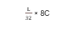
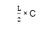
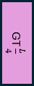
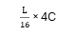
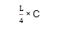
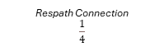
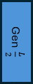

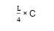


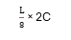
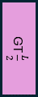
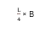
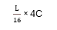
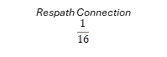
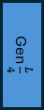
1
Respath Connection
$$\frac{1}{4}$$
0
L
1
0
0
Respath Connection
$$\frac{1}{8}$$
D
1
1
0
1D SwinTransformer Block X2
1D SwinTransformer Block X2
1D SwinTransformer Block X2
Patch Expansion
Patch Expansion
Patch Expansion
1
Signal Patch Partition
Final Patch Expansion_X4
0
Cyc. Shift
Dual Mask GA Block
1
0
1D SwinTransformer Block X2
1D SwinTransformer Block X2
1D SwinTransformer Block X2
1
Linear Embedding
Respath Connection
$$\frac{1}{16}$$
Linear Projection
0
Patch Merging
Patch Merging
Patch Merging
0
$\frac{L}{4}$ × B
$\frac{L}{4}$ × C
$\frac{L}{8}$ × 2C
$\frac{L}{16}$ × 4C
$\frac{L}{16}$ × 4C
$\frac{L}{8}$ × 2C
$\frac{L}{4}$ × C
L × C
1
0
0
Encoder
Decoder
Final Patch Expansion_X2
D
1
1
1D SwinTransformer Block
1D SwinTransformer Block
0
1
Linear Projection
GT $\frac{L}{2}$
Gen $\frac{L}{2}$
0
1
0
1
$\frac{L}{32}$ × 8C
BottleNeck
$\frac{L}{2}$ × C
1
0
Final Patch Expansion_X2
D
0
1
1
Linear Projection
0
GT $\frac{L}{4}$
Gen $\frac{L}{4}$
1
0
1
0
$\frac{L}{4}$ × C

Slide 4
Input
Layer Norm
Layer Norm
$$\text{Cosine}\text{(}\text{q}\text{,}\text{k}\text{)/}τ$$
$$\text{Cosine}\text{(}\text{q}\text{,}\text{k}\text{)/}τ$$
q
k
v
q
k
v
W-MHSA
SW-MHSA
RPE
RPE
Layer Norm
Layer Norm
MLP
MLP
Output
1D Shifted Window Transformer Block

Slide 5
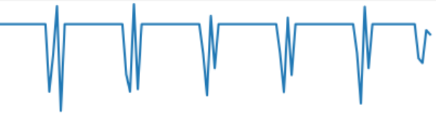
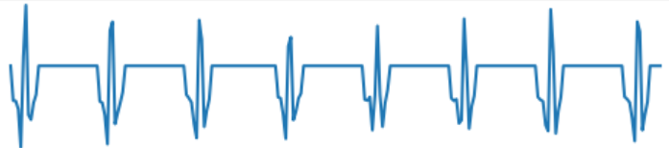
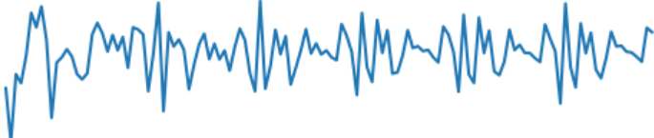
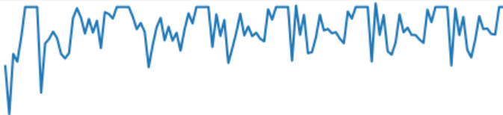
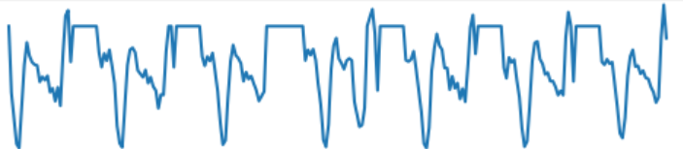
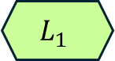
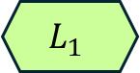
$$L_{1}$$
1X1 Conv
BN
Sigmoid
$$L_{1}$$
element-wise sum
1X1 Conv
BN
Tanh
Dual Mask Guided Attention(GA) Block

Slide 6
Real ECG
Reconstructed ECG
1
0
1
0
0
1
0
1
1
0
1
124 × 128
Validity Score
40 × 256
12 × 512
10 × 1

Slide 7
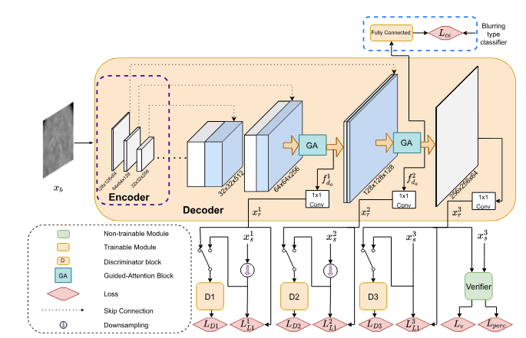
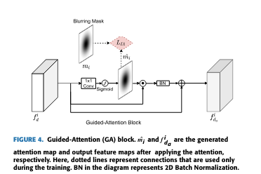

Slide 8
Real ECG
Reconstructed ECG
1
1
0
0
1
1
124 × 128
1
0
Validity Score
40 × 256
0
12 × 512
9 × 1
Discriminator: PatchGAN

Slide 9
Real ECG
Reconstructed ECG
Base Discriminator: PatchGAN
1
1
0
0
1
1
124 × 128
1
0
Validity Score
40 × 256
0
12 × 512
9 × 1
Packing Discriminator (Packing Level 3)

Slide 10
Update
0
1
1
Real PPG
Generator
1DSWinUNet
Reconstructed ECG
0
Discriminator
PatchGAN
1
0
Real ECG
0
1
1
Predicted Validity Score

Slide 11
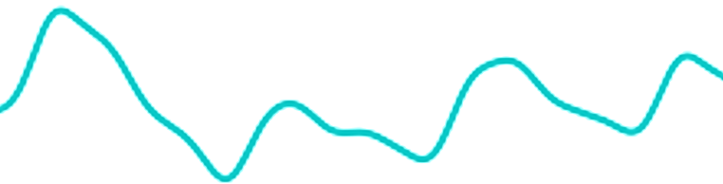
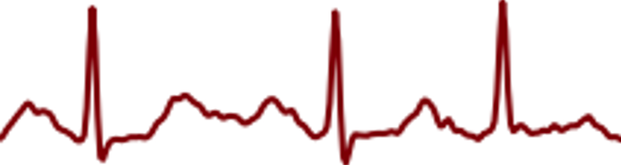
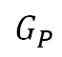
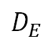
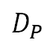
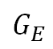
Gen. ECG
Gen. PPG
$$G_{E}$$
$$G_{P}$$
PPG (GT)
0
1
1
$$D_{E}$$
0
$$D_{P}$$
1
0
0
Real ECG
1
1

Slide 12
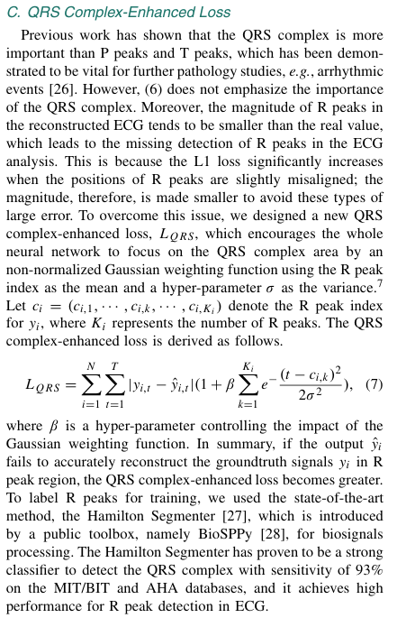
a sequence transformer network which automatically calibrates the offset
an attention network, which dynamically identifies regions of interest
a new QRS complex-enhanced loss for better reconstruction.

Slide 13
MutiStage GAN + Dynamic Loss: Bidmc Dataset
Best Results:
epoch: 358
rmse_mean: 0.24650559, rmse_std: 0.090368375
epoch: 378
p_mean: 0.555288431, p_std: 0.29616014
epoch: 358
r_squared_mean: -0.024943085, r_squared_std: 0.941383509
epoch: 358
frechet distance mean: 5.577784933 frechet distance std: 2.044802889

Slide 14
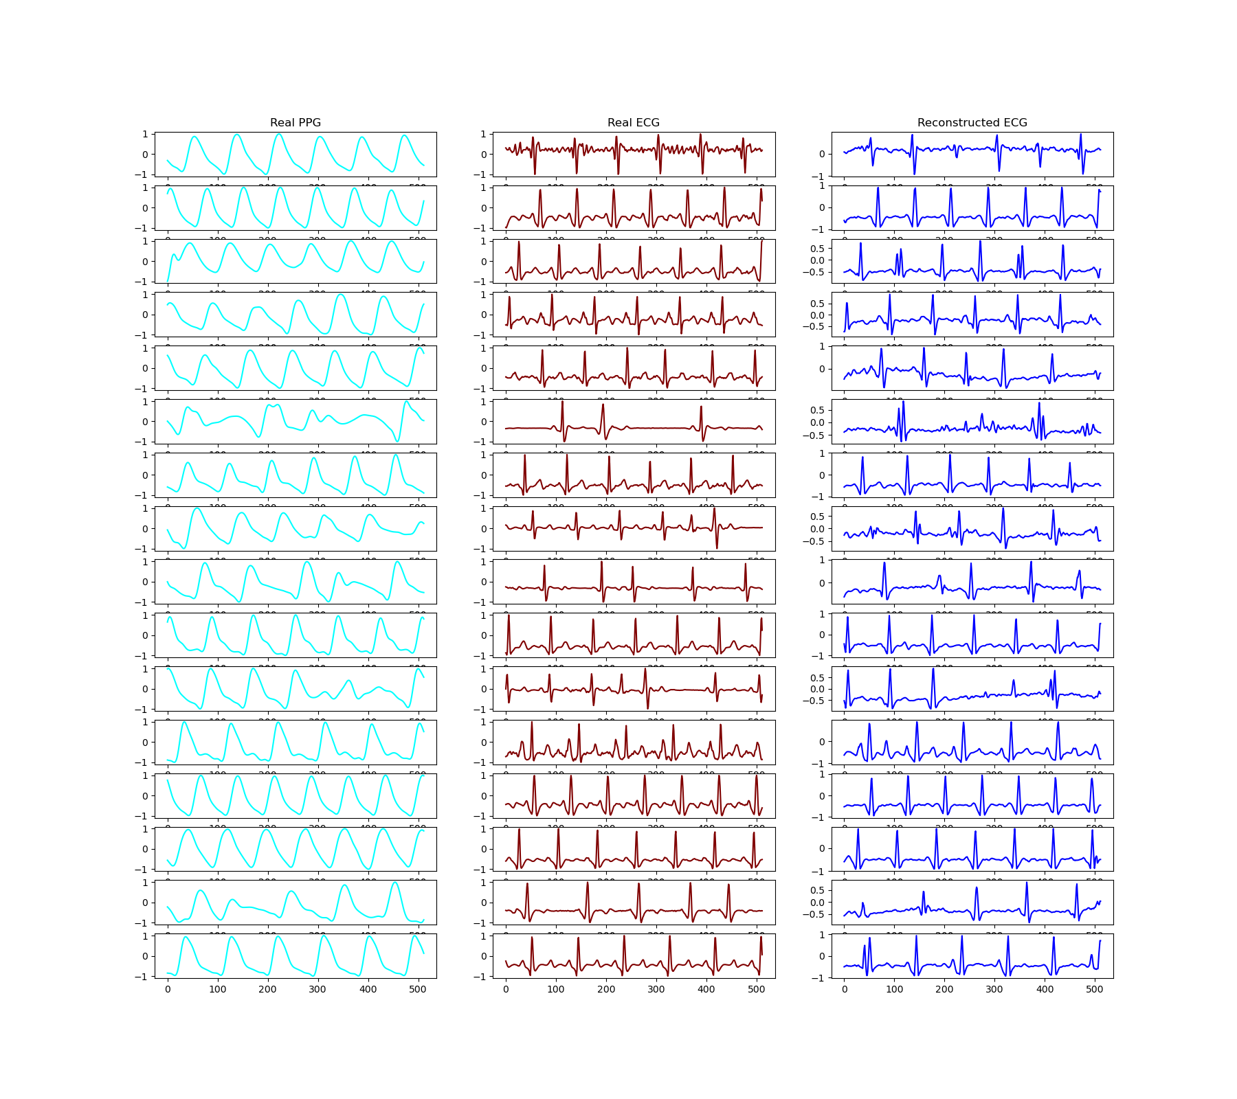

MutiStage GAN + Dynamic Loss: Bidmc Dataset

Slide 15
MutiStage GAN + Dynamic Loss: CapnoBase Dataset
Best Results:
epoch: 988
rmse_mean: 0.18393296, rmse_std: 0.075
epoch: 988
p_mean: 0.683, p_std: 0.215
epoch: 959
r_squared_mean: 0.26, r_squared_std: 0.93
epoch: 988
frechet distance mean: 4.16 frechet distance std: 1.6

Slide 16


MutiStage GAN + Dynamic Loss: Capnobase Dataset

Slide 17
MutiStage GAN + Dynamic Loss: Mimic_AFib Dataset
Best Results:
epoch: 584
rmse_mean: 0.332, rmse_std: 0. 118
epoch: 614
p_mean: 0.246, p_std: 0.216
epoch: 610
r_squared_mean: 0.928871087223809, r_squared_std: 1.48121876841374
epoch: 584
frechet distance mean: 7.52 frechet distance std: 2.6

Slide 18



MutiStage GAN + Dynamic Loss: MIMIC_AFib Dataset

Slide 19
MutiStage GAN + Dynamic Loss: MIMIC_non_AFib Dataset
Best Results:
epoch: 260
rmse_mean: 0.287, rmse_std: 0.0915
epoch: 240
p_mean: 0.198, p_std: 0.071
epoch: 260
r_squared_mean: 0.072, r_squared_std: 0.929
epoch: 260
frechet distance mean: 7.21 frechet distance std: 2.049

Slide 20

MutiStage GAN + Dynamic Loss: MIMIC_non_AFib Dataset

